Slide 1

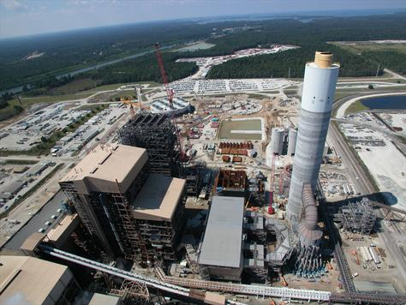
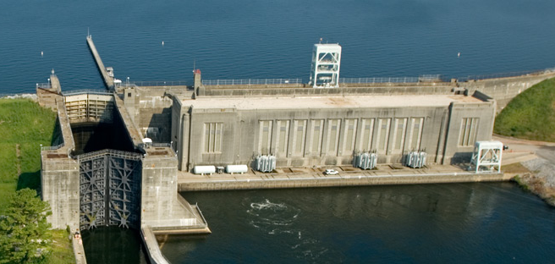
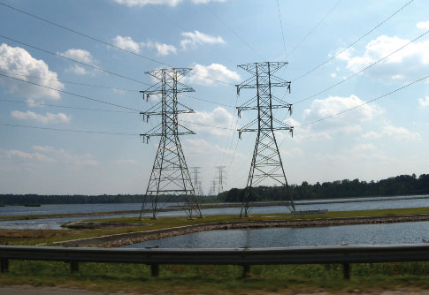
South Carolina Public Service Authority
Presentation to:
Public Service Authority Evaluation and Recommendation Committee
August 22, 2018
Notes:
Slide 1 – Cover
Thank you for joining us today
I’m Jeff Armfield and I serve as the Senior Vice President and Chief Financial Officer for Santee Cooper

Slide 2
Agenda
Santee Cooper Overview
Current and Historical Financial Position
Cost Components
Customer Rates
Coordination Agreement
Projected Financials
Legal Matters and Nuclear Project
2

Slide 3
Board of Directors
Board Basics
Appointed by Governor
Screened by Public Utilities Commission
Confirmed by State Senate
Minimum term of 7 years
Can only be removed for cause
12 members
  One from each congressional district of state (7)
  One from each county of Berkeley, Horry and Georgetown (3)
  Two at-large seats, one of whom is Chairman (2)

Slide 4
Santee Cooper Overview
Our Business
Our Customers
Our Assets
An electric and water utility headquartered in Moncks Corner, South Carolina
Owned by the State of South Carolina
  Initial funding from federal grants and issued debt
  No State funding
  1% of projected revenue paid to the State annually
One of the nation's largest public power utilities:
$13.2 billion of assets (YE 2017)¹
$1.8 billion total revenue (2017)
Retail and wholesale provider serving 2 million South Carolinians
Provided over 22,700 GWh in 2017 to its customers
Largest customer is Central Electric Power Cooperative; providing approximately 59% of Authority’s revenues
Power supply comes from 5,100 MW of owned generation
Power supply portfolio is coal, natural gas, purchased power and nuclear generation
5,112 miles of Transmission Lines
2,934 miles of Distribution Lines
2017 Customer Sales (% of MWh’s)
2017 Energy Sources
(MWh)
Our Rates
Board assigned rate making ability
Approximately 75% of Santee Cooper revenues are derived from adjust to actual rates
Central: cost of service adjustment to actual
Retail rates: fuel & demand sales adjustment clauses
Includes regulatory assets (impaired nuclear)
Notes:
Slide 5 - Santee Cooper Overview
Before we begin our update, let me provide an overview of Santee Cooper
Santee Cooper is owned by the people of South Carolina and is the state’s largest provider of power
We are one of the nation’s largest public power utilities and serve over 2 million South Carolinians
A unique feature of Santee Cooper is that we are both a retail and a wholesale provider of electricity
Central Electric Power Cooperative is our largest wholesale customer and provides 59% of Santee Cooper’s revenue
Central is under contract to purchase power from Santee Cooper through at least 2058
Santee Cooper meets all of its customers’ energy needs through its over 5,100 MW of owned generation capacity, which is primarily coal based, supplemented by natural gas, nuclear power and purchased power
Santee Cooper’s Board of Directors have exclusive authority to set and approve its rates, and those rates are not subject to review by the South Carolina Public Service Commission

Slide 5
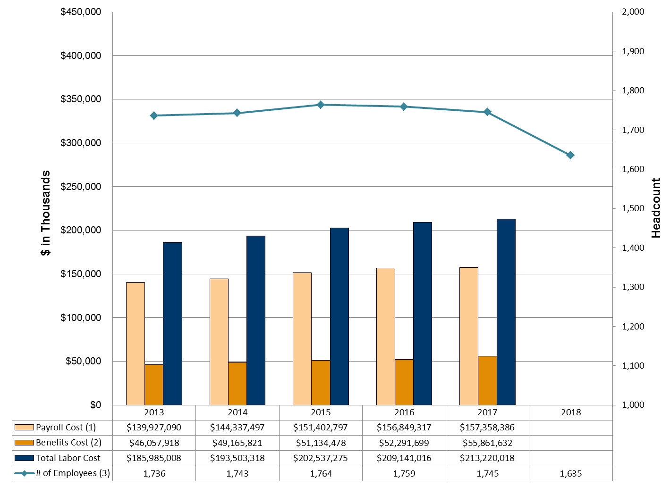
Payroll and Benefits Cost
_____________________________________________
Includes base pay, overtime, leave, and incentive pay.
Includes employer portion of Social Security tax, Medicare tax, Unemployment, Workers Comp, Retirement, Health Ins, Dental Ins, & Disability Ins.
Employee headcount was 1,635 as of July 31, 2018.
5
Notes:
An overview of Santee Cooper’s power supply shows that it continues to have access to low cost generating units with high availability base load.

Slide 6
Current and Historical Financial Position

Slide 7
Recent Financial Results
($000’s)
Historical Financials
YEARS | 2013 | 2014 | 2015 | 2016 | 2017⁽¹⁾
BALANCE SHEET
ASSETS & DEFERRED OUTFLOWS
Capital Assets | $ 6,375,051 | $ 6,917,786 | $ 7,509,121 | $ 8,214,787 | $ 4,832,022
Regulatory Assets - Nuclear | 0 | 0 | 0 | 0 | 4,248,478
Cash, Cash Equivalents, & Investments | 1,755,022 | 1,940,302 | 2,105,580 | 1,827,928 | 1,842,914
Fuel Inventory | 610,145 | 484,225 | 669,706 | 584,292 | 414,699
Other Assets & Deferred Outflows | 1,967,378 | 1,865,918 | 1,966,114 | 1,882,817 | 1,862,301
Total Assets & Deferred Outflows | $10,707,596 | $11,208,231 | $12,250,521 | $12,509,824 | $13,200,414
LIABILITIES & DEFERRED INFLOWS
Debt | $ 6,962,123 | $ 7,198,990 | $ 8,076,885 | $ 8,668,870 | $ 8,309,172
Pension Liability | 0 | 0 | 286,300 | 324,956 | 338,783
Asset Retirement Obligation Liability | 1,024,253 | 1,043,629 | 1,046,054 | 739,821 | 729,969
Regulatory inflows - Toshiba settlement | 0 | 0 | 0 | 0 | 898,215
Other Liabilities & Deferred Inflows | 681,093 | 797,149 | 899,492 | 745,841 | 803,008
Total Liabilities & Deferred Inflows | $ 8,667,469 | $ 9,039,768 | $10,308,731 | $10,479,488 | $11,079,147
NET POSITION | $ 2,040,127 | $ 2,168,463 | $ 1,941,790 | $ 2,030,336 | $ 2,121,267
TOTAL LIABILITIES, DEFERRED INFLOWS & NET POSITION | $10,707,596 | $11,208,231 | $12,250,521 | $12,509,824 | $13,200,414
REINVESTED EARNINGS
Total Revenues & Income | $ 1,816,576 | $ 1,997,347 | $ 1,879,553 | $ 1,745,657 | $ 1,756,983
Total Expenses & Interest Charges | (1,744,960) | (1,894,217) | (1,781,591) | (1,604,119) | (1,618,080)
Other | 14,322 | 45,865 | (43,447) | (33,800) | (30,221)
Reinvested Earnings Prior to Payment to State | $ 85,938 | $ 148,995 | $ 54,515 | $ 107,738 | $ 108,682
(1) Does not include net unfunded Other Post Employment Benefits Liability of $171.9 million. Per GASB 75, this liability will be booked beginning in 2018.

Slide 8
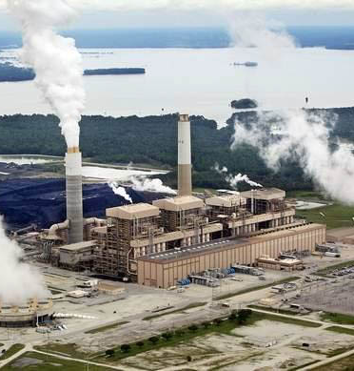
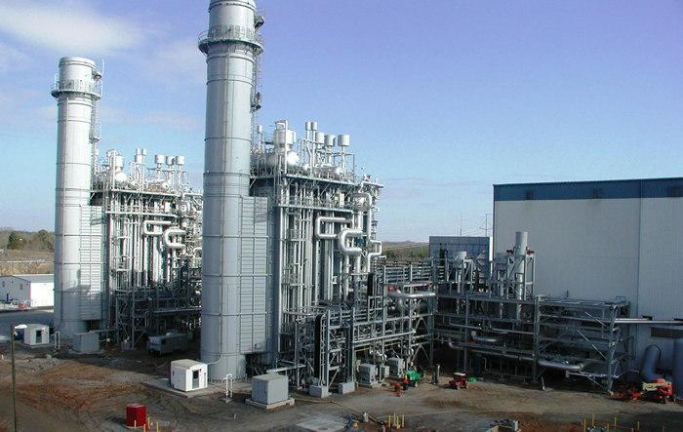
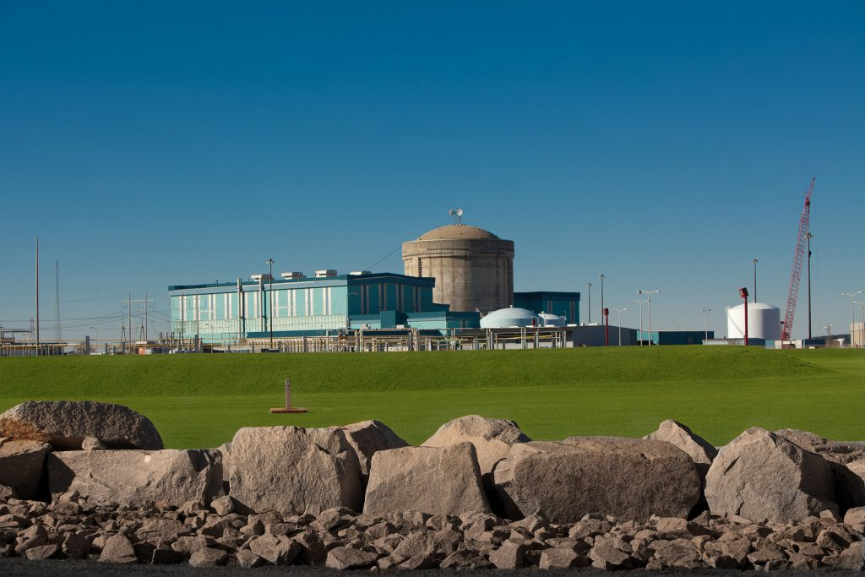
Power Supply Detail
Cross Generating Station (36.8% of 2017 Energy) – Net Book Value: $1.6B
Location
Unit | Service Date | Energy Source | 2017 Energy (GWh) | % of 2017 Energy
1 | 1995 | Coal | 1,911 | 8.4%
2 | 1983 | Coal | 27 | 0.1%
3 | 2007 | Coal | 3,713 | 16.3%
4 | 2008 | Coal | 2,724 | 11.9%
Pineville, SC
Rainey Generating Station (25.4% of 2017 Energy) – Net Book Value: $213.2M
Location
Unit | Service Date | Energy Source | 2017 Energy (GWh) | % of 2017 Energy
1 | 2002 | Gas | 3,695 | 16.2%
2A, 2B, 3, 4, 5 | 2002 - 2004 | Gas | 2,087 | 9.1%
Iva, SC
Summer Nuclear Unit 1 (10.1% of 2017 Energy) – Net Book Value: $218.9M
Location
Unit | Service Date | Energy Source | 2017 Energy (GWh) | % of 2017 Energy
1 | 1983 | Nuclear | 2,296 | 10.1%
Jenkinsville, SC

Slide 9
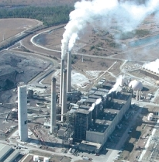
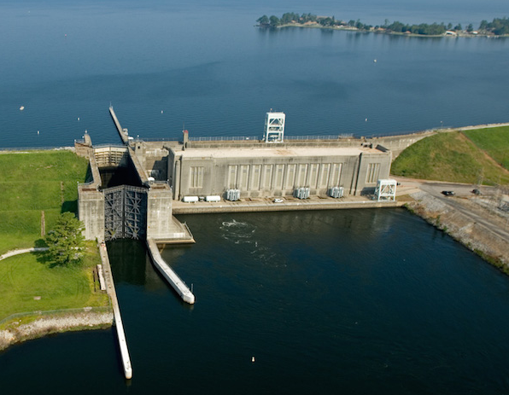
Power Supply Detail (cont.)
Winyah Generating Station (5.3% of 2017 Energy) – Net Book Value: $375.1M
Location
Unit | Service Date | Energy Source | 2017 Energy (GWh) | % of 2017 Energy
1 | 1975 | Coal | 469 | 2.1%
2 | 1977 | Coal | 178 | 0.8%
3 | 1980 | Coal | 186 | 0.8%
4 | 1981 | Coal | 380 | 1.7%
Georgetown, SC
Jefferies Hydroelectric Generating Station (1.0% of 2017 Energy) – Net Book Value: $106.5M
Location
Unit | Service Date | Energy Source | 2017 Energy (GWh) | % of 2017 Energy
1 | 1942 | Hydro | 220 | 1.0%
Moncks Corner, SC

Slide 10
Transmission & Distribution
Transmission | Distribution
5,112 Miles of Lines | 2,934 Miles of Lines
Net Book Value $785.6M | Net Book Value $384.6M

Slide 11
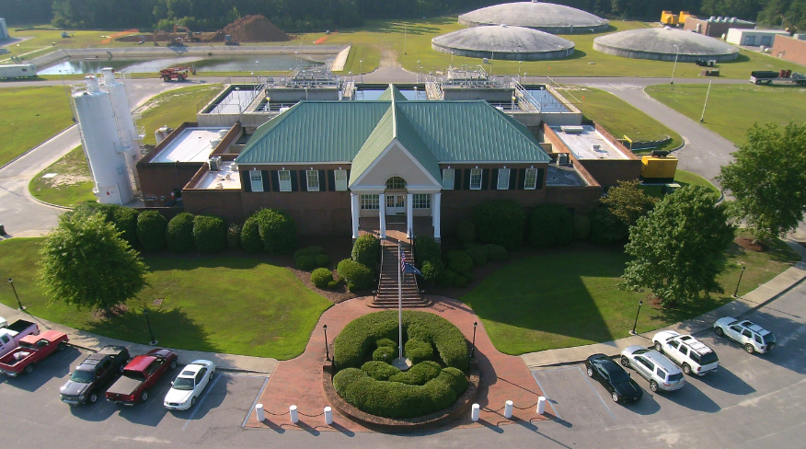
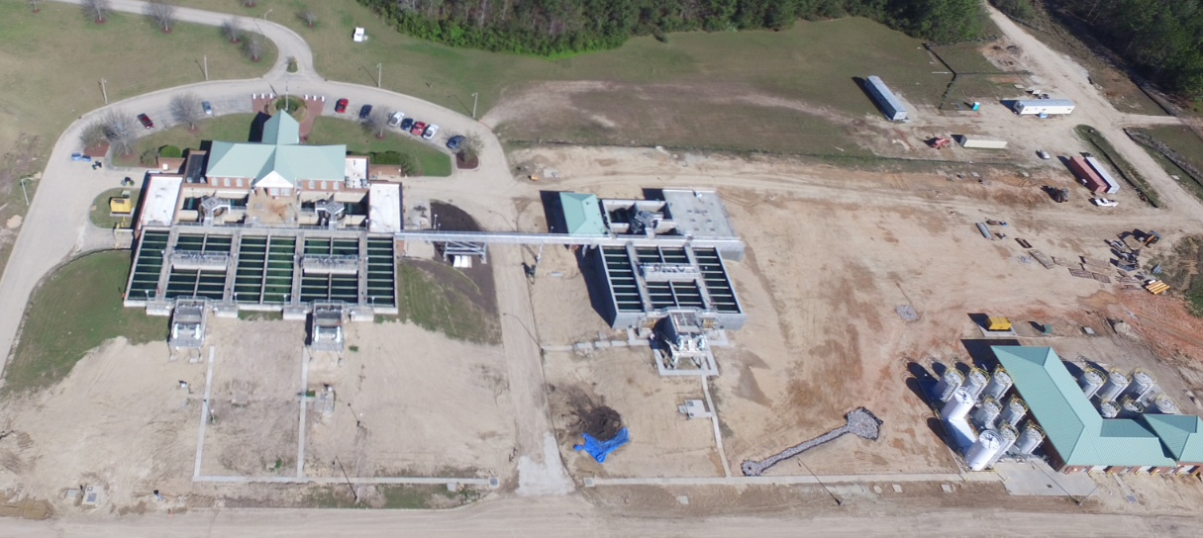
Lake Moultrie Water System
Summerville CPW
City of Goose Creek
Moncks Corner Public Works
Berkeley County Water & Sanitation Authority
  Capable of producing 28 million gallons per day and expanding to produce 40 million gallons per day
  Ultimately serves a population of over 182,000 people
  Net Book Value: $46,143,584

Slide 12
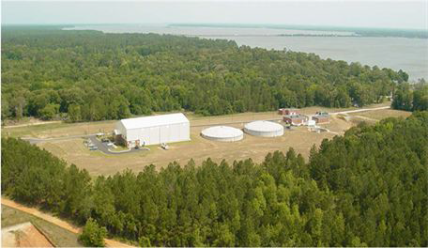
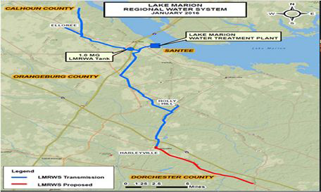
Lake Marion Water System
Town of Santee
Orangeburg County
Dorchester County
Calhoun County
Berkeley County
  Capable of producing 8 million gallons per day
  Ultimately serves a population of over 2,900 people
Net Book Value: $0 Grant Funded

Slide 13
Santee Cooper Leasing Program
Lease Lot Sales Program: 210 remaining
  Available for sale when current lease expires
  2,533 leased lots originally available for sale,
  83% have been sold
Residential Lease Program: 421 leased lots
  Within lake project boundary – can not be sold
  Subdivisions - Thornley, Overton, Halls, Cantey Bay, Washington Point Subdivision
  Miscellaneous leases within the project boundary but not a subdivision
Commercial Lease Program: 53 commercial lease sites
  Camp grounds
  Marinas
  Fish camps
  Other
Residential Marginal Leases: 1461 leases
  Within the lake project boundary
  Strip between adjacent property and lake
  Cannot be sold

Slide 14
Recreation Sites – Lake Moultrie
18 sites , 3504 acres
RECREATION SITES ON LAKE MOULTRIE
Official Name | Alternate Names | Operating Manager | Acreage Inside & Outside Project
Hatchery Landing | -- | SCPSA | 2,271 ac. inside project, 3.65 acre parking
West Dike Landing | -- | SCPSA | .84 Acres inside Project
Richardson's Landing | -- | SCPSA | 5.87 Acres
General Moultrie Landing | -- | SCPSA | .46 Acres
Thornley Forest Landing | -- | SCPSA | 1.61 Acres
Wilson's Landing | -- | SCPSA | 2.64 Acres
William Dennis Landing | Biggins | SCPSA | 2.67 Acres
Rembert Dennis Landing | Wadboo | Berkeley County Government | 1.83 Acres
Amos Gourdine Landing Henderson Guerry Landing | Russellville Landing | SCPSA | 13.25 Acres
Fred Day Landing | Duck Pond | Berkeley County Government | 1.27 Acres
Palmetto Trail (Portion of) | -- | SCPSA/The Palmetto Conservation Foundation | N/A
Lions Beach | -- | YMCA | 3.44 Acres
Short Stay Naval Facility | Short Stay | US Government | 49.11 Acres
Overton Park | -- | SCPSA | 20 Acres – NBV $847K
Camp Moultrie | Boy Scout Camp | US Boy Scouts of America | 12 Acres
Cross Generating Station | -- | SCPSA/DNR (Youth Hunts) | 384.18 ac. inside project, 574.14 ac. outside project

Slide 15
Recreation Sites – Lake Marion
16 sites, 7902 acres
RECREATION SITES ON LAKE MARION
Official Name | Alternate Names | Operating Manager | Acreage Inside & Outside Project
Low Falls Landing | -- | SCPSA | 2.29 Acres
Calhoun Landing | Stumphole Landing | SCPSA | 3.29 Acres
Borrow Pit Landing | -- | SCPSA | 1.53 Acres
Alex Harvin Landing | Birch Branch | SCPSA | 3.34 Acres
White Oak III Landing | -- | SCPSA | 1.76 Acres
Rowland Landing | -- | SCPSA | 1.65 Acres
John C. Land Landing and Event Center | Log Jam Landing | SCPSA | 15 Acres
Taw Caw Landing | -- | SCPSA | 1.75 Acres
Cathead Landing | Big Cathead | SCPSA | 2.2 Acres
Eutaw Springs Landing | Little Cathead | SCPSA | 2.4 Acres
Rimini Landing | Packs | SCPSA | 3 Acres
Taw Caw Park | -- | Clarendon County Government | 8 Acres
Sparkleberry | -- | SCPSA | 2 Acres
Indian Bluff | -- | Orangeburg County Government | 32.1 Acres
Spiers Landing | -- | Berkeley County Government | 11.45 Acres
Islands inside Lake Marion | various | SCPSA/DNR | 597 ac. inside project
Palmetto Trail (Portion of) | -- | SCPSA/The Palmetto Conservation Foundation | N/A
Other - Lease 7214 acres to USFWS for Santee National Wildlife Refuge

Slide 16
Wildlife Management Areas (WMA’s)
Program with SCDNR:
Public access to hunting areas
General outdoor recreation – canoe trails, hiking, bird watching
19 sites
26,651 acres enrolled
Santee Cooper's WMAs around Lake Marion
Tract Name | Acres Total
Bluefield | 738.00
Islands | 597.00
Potato Creek Hatchery | 224.00
Hickory Top | 2,355.00
Diversion Canal | 407.00
Santee Cooper WMA | 3,622.00
Rocks Pond | 480.00
Santee Dam | 1,066.00
Mill Creek | 200.00
Broughtons | 1,115.00
Total | 10,804.00
Santee Cooper's WMAs around Lake Moultrie
Tract Name | Acres Total
Hatchery | 2,362.00
North Dike | 4,372.00
Cross Generating Station | 717.00
Greenfield | 1,086.00
Halls | 1,263.00
Wadboo | 3,154.00
Porcher Addition | 138.00
Total | 13,092.00
Santee Cooper's WMA "Pee Dee Site"
Tract Name | Acres Total
Pee Dee | 2,660.00
Total | 2,660.00
Santee Cooper's WMA "Pacolet Site"
Tract Name | Acres Total
Pacolet | 95.00
Total | 95.00

Slide 17
Other Recreation and
Conference Facilities
Somerset: 36 acres owned by Santee Cooper as a current and retiree employee recreation facility.
Wampee Conference and Training Center: 124 acre complex owned and operated by Santee Cooper for board meetings, employee training, customer events, government meetings, nonprofit events and public meetings.
Old Santee Canal Park: 195 acres owned by Santee Cooper as a public park and conference center on Tail Race Canal. Santee Cooper took over park and management in 1999 from State.

Slide 18
Economic Development Sites
5 sites, 4243 acres
Site | County | Acreage
Camp Hall | Berkeley | 3,984
Jefferies | Berkeley | 50
Ascott Valley | Horry | 117
Grainger | Horry | 12
Loris Commerce Park | Horry | 80

Slide 19
Impact to State Since 2012
Economic Development Grants - $40 million
Economic Development Loans - $93 million
Jobs Created – 30,457
Capital Investment attracted to State - $7 billion

Slide 20
2017 Highlights
Inland Port Dillon
  Support intermodal cargo volumes between the Port of Charleston and markets throughout the Carolinas, Northeast, and Midwest.
  45,0000 containers annually
  Loan ($15 million) and grant ($5 million)
Fiber Industries LLC
  Textile production operation in Darlington County
  $500,000 grant for site work
  $30 million capital investment and 135 new jobs
Harbor Freight Tools Expansion
  One million-square foot expansion of its East Coast Distribution Facility located in Dillon County.
  $500,000 grant for site expansion
  $200 million capital investment and 500 new jobs

Slide 21
2017 Highlights
Ruiz Foods Products, Inc. Expansion
  Expanding their frozen food and snack product operations in Florence County
  $300,000 grant for site related work
  $79 million capital investment and 705 new jobs
Samsung Home Appliance
  Opening of home appliance manufacturing plant in in Newberry County
  $2.75 million grant for purchase and development of an existing building.
  $380 million capital investment and 954 new jobs by year 2020
Volvo
  Expanding their initial investment to include a second line of production.
  $2.175 million grant for development
  $520 million capital investment and 1,910 new jobs

Slide 22








Select Announcements

Slide 23
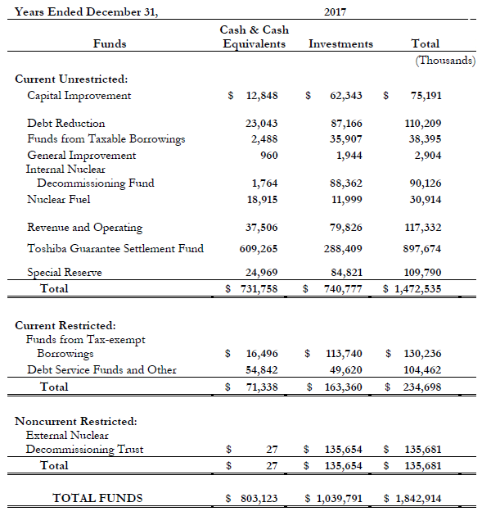
Cash and Cash Equivalents

Slide 24
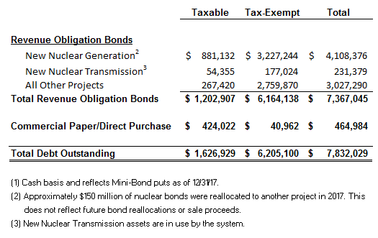
Debt Outstanding as of 12/31/17¹
($000’s)

Slide 25
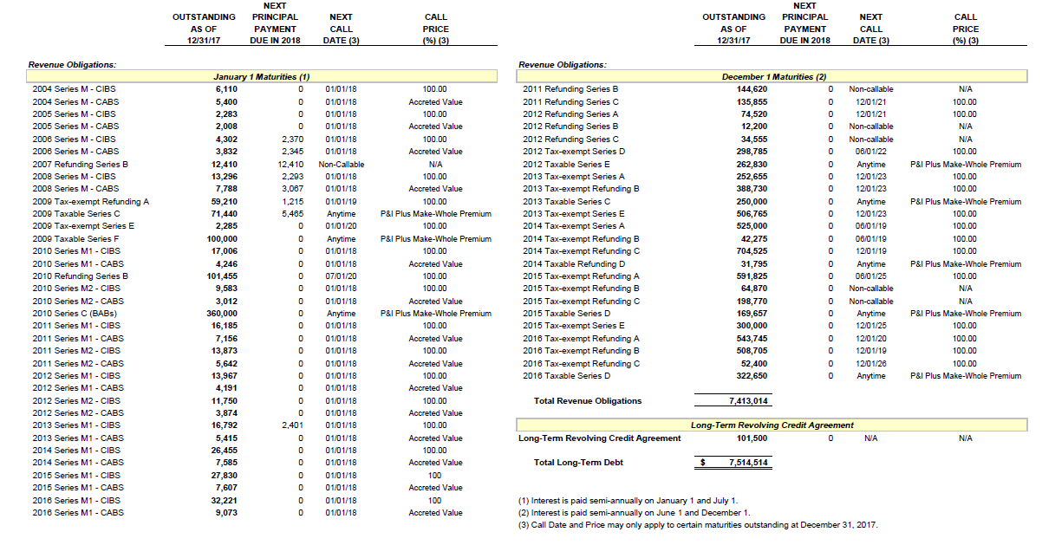
Long-Term Debt Outstanding
Dollars in Thousands

Slide 26
Mini-Bonds
South Carolina residents and Santee Cooper and Cooperative customers can invest in Mini-Bonds
Investors may invest from $200 to $50,000 per issue
These tax free bonds allows interest earned to be excluded from gross income for federal and South Carolina income tax
Approximately 10,000 South Carolina residents are Mini-Bondholders
There were $272,341,200 Mini-Bonds outstanding as of 12/31/17

Slide 27
Status and Cost of Recent Financings
Series | Par ($mm) | TIC
2008A | 407.0 | 5.77%
2008B | 260.0 | 7.56%
2009B | 164.1 | 4.83%
2009C | 87.0 | 6.10%
2009E | 284.8 | 4.21%
2009F | 100.0 | 5.82%
2010C | 360.0 | 4.24%
2012D | 312.2 | 4.30%
2012E | 262.8 | 4.27%
2013AB | 641.4 | 5.32%
2013C | 250.0 | 5.83%
2013E | 506.8 | 5.34%
2014A | 600.0 | 4.92%
2014C | 704.5 | 3.79%
2015ABCD | 1,103.7 | 4.11%
2015E | 300.0 | 4.73%
2016A | 543.7 | 3.65%
2016BD | 831.4 | 3.52%
2016C | 52.4 | 3.10%
1
2
1
3
4
5
6
3
10
7
2
5
12
8
9
7
10
8
13
11
4
12
6
14
15
16
19
13
11
18
14
9
15
16
17
17
18
19

Slide 28
Municipal Bond Types
Santee Cooper funds its Capital needs with Revenue Bonds
Two most common types of municipal bonds are:
  General Obligation Bonds (GO Bonds) – issued by states, cities or counties
    These bonds are backed by the “full faith in credit” of the issuer which has the power to tax residents to pay bondholders
  Revenue Bonds
    These bonds are backed by an interest in revenue stream or revenue source rather than by taxing power

Slide 29
Bonds
Santee Cooper issues a combination of tax-exempt and taxable Revenue Bonds under its Revenue Obligation Bond Resolution
  Tax-Exempt - Most public power utilities are allowed to issue bonds and the interest on which is not subject to income tax for the holder of the bond. This is because bonds issued by a governmentally-controlled utility is deemed to be for a “governmental purpose” and qualifies for tax-exemption.
  Taxable – An exception to the tax-exempt nature of municipal bonds are those deemed to be for “private use” under the Internal Revenue Code. Roughly 20% of the bonds issued by Santee Cooper are taxable.
Call Options and Refinancing
  Tax-Exempt – in most cases callable 10 years after the issue date
  Taxable – callable anytime with a make whole call provision

Slide 30
Other Liabilities, Commitments and
Contingencies - Exposure as of 12/31/17
Examples of other liabilities, commitments and contingencies include:
  Liabilities
    Net Unfunded Pension Liability - $338.8M
    Nuclear Decommissioning - $414.8M
    Ash Pond Closures - $315.2M
    Net Unfunded Other Post Employment Benefits Liability - $171.9M
    Natural Gas Hedges - $37.4M
  Commitments and Contingencies
    American Gypsum Contract
    Coal Supply & CSX Contracts
    Nuclear Fuel Obligation
    Rainey Service Agreement Natural Gas Transportation Service Agreements

Slide 31
Financial Metrics
Santee Cooper is committed to preserving financial health
Debt Service Coverage¹
Liquidity
²
³
Includes CP and Payments to the State
2. CP Capacity adjusted $75 million lower to account for $75 million FRN issue
3. Toshiba funds excluded from liquidity calculations
Debt to Capitalization⁴
_____________________________________________
4. Includes commercial paper and Revolving Credit Agreements.; reflects combined system
* In 2015, Santee Cooper recorded a liability of approximately $270 million as a result of GASB 68.
Notes:
Slide 20 – Financial Metrics
Supported by a favorable rate structure and commitment to recover costs, Santee Cooper has historically generated strong financial metrics.
As the graphs on this slide show, we enjoy relatively consistent and strong debt service coverage of approximately 1.4x. Please note that this coverage incorporates our subordinate commercial paper debt service as well as our payment to the State of South Carolina which is also subordinate to debt service. Our liquidity, which includes cash reserves, a commercial paper program and revolving credit facilities, is over one year of operating expenses.
In addition, our current debt-to-capitalization ratio of 80% (which includes the nuclear debt that has been issued in the past few years) is in line with our historical metrics.

Slide 32
2017 Debt to Capitalization Comparison
IOU’s have access to shareholder equity where
Public Power capitalizes primarily through debt
Compared to IOU’s
Compared to Other Public Power
Debt to Equity
Santee
Cooper
Santee
Cooper
NCMPA1

Slide 33
Credit Ratings Compared
to Investor Owned Utilities
Santee Cooper Compared to Other Utilities Senior Secured Debt Rating (8/16/2018)
Duke
Carolinas
Duke
Progress
AAA Aa1 Aa2 Aa3 A1 A2 A3 Baa1 Baa2 Baa3
Georgia
Power⁷
AAA AA+ AA AA- A+ A A- BBB+ BBB BBB-
Duke
Progress
Duke
Carolinas
Georgia
Power⁷
AAA AA+ AA AA- A+ A A- BBB+ BBB BBB-
Moody’s downgraded Santee Cooper’s A1 long term rating to A2 and left the negative
outlook on August 17, 2018
2. SCE&G was downgraded by Moody’s on 2/5/2018
3. Fitch withdrew Duke Carolinas and Duke Progress ratings in April 2017
4. Fitch placed Santee Cooper’s A+ rating on Rating Watch Negative on March 7, 2018
5. SCE&G downgraded to BBB+ by Fitch and A- by S&P on September 29, 2017
S&P affirmed Santee Cooper’s A+ rating and left the negative outlook on August 21, 2018
Georgia Power was downgraded by Moody’s (8/8/2018) and Fitch (8/10/2018) and placed on credit watch by all three agencies.
SCE&G was downgraded by Fitch (8/8/2018) and S&P (8/9/2018), to BBB and BBB+, respectively

Slide 34
Credit Ratings Compared
to Other Public Power
Santee Cooper Compared to Other Utilities Senior Secured Debt Rating (7/10/2018)
Santee
Cooper¹
OUC
NCMPA1
MEAG⁴
AAA Aa1 Aa2 Aa3 A1 A2 A3 Baa1 Baa2 Baa3
NCMPA1
OUC
MEAG⁴
AAA AA+ AA AA- A+ A A- BBB+ BBB BBB-
NCMPA1
OUC
MEAG⁴
AAA AA+ AA AA- A+ A A- BBB+ BBB BBB-
Moody’s downgraded Santee Cooper’s A1 long term rating to A2 and left the negative outlook on August 17, 2018
2 Fitch placed Santee Cooper’s A+ rating on Rating Watch Negative on March 7, 2018.
S&P affirmed Santee Cooper’s A+ rating and left the negative outlook on August 21, 2018
MEAG Power’s rating outlook was changed to negative by Moody’s (8/14/2018), negative by S&P (8/14/2018), and Rating Watch Negative by Fitch (8/10/2018)

Slide 35
Credit Rating Agency
Strengths & Challenges
The credit agencies identified the following strengths and challenges for Santee Cooper:
  Strengths
    Board has full authority to establish rates
    Automatic rate adjustments on over 75% of costs.
    Long-term contract with Central to 2058
    Competitive rates
    Long-term record of sound financial metrics
    Strong generation performance with below-average power production costs
    Economy positive for customer sales growth
    Broad and diverse customer base
  Challenges
    Lack of governance certainty and further political influence on Santee Cooper operations
    High leverage
    Central litigation
    Authority’s ability to collect nuclear costs in rates
    Potential restrictions on rate setting autonomy
    Potential sale of the Authority

Slide 36
Cost Components

Slide 37
Santee Cooper Electric System:
Overview of Cost Components
Fuel and Purchased Power account for ~42% of Santee Cooper’s costs
COST OF SERVICE REVENUE REQUIREMENTS
Fuel & Purchased Power
+ Non-Fuel O&M
+ Debt Service
+ Payment to State & Sums in Lieu (PTS, SIL)
+ Working Capital (WC)
Subtotal
+ Capital Improvement Fund (CIF)
Total Revenue Requirement (“Cost”)
2018 Total Revenue Requirement
(millions)
$1,723
Notes:
Overview of our major cost components:
Prior pages we presented our target range – topline view of cost we should target.
This is a bottoms up view – over the next few weeks we will work to develop and finalize our assumptions for all these cost components
Cost reductions
1. Departmental input was solicited for reductions to budget
2. Achieve savings through a combination of NFOM and Capital reductions
3. Reducing capital achieves savings from interest expense and produces excess capital improvement funds to defease near term d/s

Slide 38
Projected Revenue Requirements (2018 Budget)
Combination of Non-Fuel O&M and capital reductions lowered annual costs by ~$40 million on average from 2018-2020 compared to prior projections
Cost reduction in combination with debt defeasance funded with Toshiba settlement funds enabled Santee Cooper to avoid rate increases in 2018 and 2019
__________
Chart values shown in millions of dollars.
Board approved 2018 budget and planning years for 2019 and 2020.
38
Notes:
In conjunction with the upcoming budget cycle, management expects to achieve ~$40 million reduction in annual cost
O&M and Capital reductions are illustrative of preliminary projections as compared to FF1701
These exclude any direct impact due to nuclear suspension
Capital Reductions- Due to changes in issuances & defeasance amounts
Resulting CIF- Excluding defeasance amounts

Slide 39
Actual
System Fuel Rate Actuals and Projections (2012-2022)
Projected
$/ MWh
Source- Fuel Forecast-Oct 2017 Update and related scenarios.
39
Notes:
This graph shows the actual and projected Annual System Rate. The red dashed line is per the 2018 Budget (Oct 2017 Dispatch).
Our system rate in 2019-2022 is expected to be lower than it has been in the past 6 years.
These rates may be even lower as we continue to work on strategies to lower fuel costs across all our resources.
I’ll share an example of these efforts later in the presentation when I talk about our renegotiated rail contract.

Slide 40
Fuel Strategies
Coal
  Manage to stockpile targets
  Diversify suppliers/basins
  Use short-term & spot purchases
  to drive down costs
Natural Gas
  Manage hedge position
  Analyze economics of purchasing excess firm pipeline
Purchased Power
  Continue import of economical purchased power
  Continue to analyze transmission import capability
Coal
Purchased Power
Natural Gas
40
Notes:
This picture is symbolic of the constant shuffle between NG, Coal, and Purchase Power. We dispatch based on economics and buy power if it’s cheaper than our own resources while ensuring that we are operating the power system securely and reliably.
This list summarizes our ongoing efforts to provide no only low fuel cost but price stability and availability. We will (1) manage our coal supply through the use of short-term contracts and diversification of suppliers, (2) continue to manage our NG hedge position and transportation needs, and (3) continue to aggressively import purchased power.

Slide 41
Toshiba Settlement Funds (2018 Budget)
Santee Cooper had $895 million available from the sale of its interest in the Toshiba Parental Guaranty¹
On September 27, 2017, Santee Cooper sold its interest in the Toshiba settlement receivable
The Board Resolution granting approval of the 2018 budget directed management to utilize settlement funds for debt reduction (defeasance, debt pay-off or avoidance)
  Defease and retire debt
  Reduce need to borrow future funds
Projected Use of Toshiba Funds and Benefits to Customers (Base Case) ^{2, 3}
($ millions) | 2018 | 2019 | 2020 | 2021 | 2022-2056 | Total
Sources
Toshiba Funds Draws | 270 | 243 | 204 | 65 | 113 | 895
Uses
Debt Defeasance ⁴ | 155 | 145 | 110 | 45 | 0 | 455
Reduce Long-Term Debt | 115 | 98 | 94 | 20 | 113 | 440
Benefits
Debt Service Savings | 162 | 159 | 130 | 66 | 803 | 1,321
In Progress
Projected / Subject to Optimization
    Use of settlement proceeds illustrated above assumed first base rate increase in 2020 and projected aggregate increase of 7-8% implemented in years 2020-2023
    Funds being deployed in 2018 consistent with approved budget, however projections for remaining years to be optimized with 2019 budget approval and as opportunities arise
    Santee Cooper is evaluating opportunities to more efficiently deploy settlements proceeds to take advantage of recent rise in interest rates by accelerating debt pay-down
____________________________________________
Excludes interest income earned on funds.
Savings from long-term debt avoidance based on interest rate projections (30-year level debt service, blended average interest rates of ~5%). Santee Cooper may pay-down existing debt, if attractive opportunities are available in the market. A portion of the funds set aside for long-term debt reduction would be utilized to offset mechanic liens.
2018 amounts per approved budget; 2019 amounts and onwards are preliminary projections and will be optimized to reflect prevailing assumptions.
Settlement funds may be drawn in prior calendar year to fund defeasance escrow.
41

Slide 42
Debt Service Profile
Access to settlement funds provide an opportunity to mitigate the near-term debt service peak and manage impact on customers’ rates
Existing and Projected Debt Service ($ million) ¹
Bond Defeasance
and Cash Funding
__________
Debt service does not include the benefit of BABs subsidy’; 2016D bullet maturity (2023) assumed to be refinanced as 30-year debt with level debt service.
Savings from long term debt avoidance based on interest rate projections (30-year level debt service, blended average interest rates of ~5%). Santee Cooper may pay-down existing debt, if attractive opportunities available in market.
42

Slide 43
Payments to the State
& Sums in Lieu
__________
1. Projections based on 2018 Budget
43

Slide 44
Customer Rates
44

Slide 45
Two Approaches to Determine
Cost of Service
Gross Revenue Requirements
Cash Basis Generally used by Public Power Utilities | Accrual Basis Generally used by Investor-Owned Utilities (IOU’s)
Operation & Maintenance Expenses Debt Service (P&I) and Lease Payments Capital Improvements Fund Requirement (DSC Req) Sums in Lieu of Taxes Working Capital | Operation & Maintenance Expenses Depreciation and Amortization Interest Expense and Return on Equity (Rate Base) Income Taxes & Property Taxes Working Capital
45

Slide 46
Rate Revision Timeline
(2015 Rate Study)
October 17, 2014 | Board Meeting: Presented the need for rate study and proposed timeline
June 22, 2015 | Sought Board approval to make formal notice of proposed rate revisions
June 23 – August 27, 2015 | Obtained written comments and conducted public meetings Public comments received at five meetings, completed on 7/21/2015 Two meetings with Central and a cooperative informational update Several meetings with the Industrial Customer Association and Retail Advisory Council Final written public comments received by 8/27/2015
October 16, 2015 | Board held public meeting to receive additional public comments. Presentation by staff on public comments received through hearings and the rate revision process
November 6, 2015 | Provided final proposed rate revisions to Board including any changes as a result of public input
December 7, 2015 | Board action on proposed rate revisions
December 7, 2015 – February 5, 2016 | Public notice period
April 1, 2016 | New rates became effective
46

Slide 47
Customers
Santee Cooper directly or indirectly serves 2 million South Carolinians
2017 Customer Composition
Retail (23% of Revenues)
(% of revenues)
Santee Cooper's retail customers include 180,000 retail customers in Berkeley, Georgetown and Horry counties as well as 26 large industrial customers
Stable Retail Customer Base
(# customers) | Residential | Commercial & Small Industrial
2013 | 140,126 | 28,687
2014 | 142,663 | 28,904
2015 | 145,208 | 28,815
2016 | 147,447 | 29,301
2017 | 151,044 | 29,614
Wholesale (63% of Revenues)
Industrial (14% of Revenues)
Central Electric Power Cooperative, Santee Cooper’s largest customer providing 59% of Santee Cooper’s revenues in 2017 (contract through 2058)
Santee Cooper’s large industrial customers have contract terms that include minimum demand charge and extended notice requirements that mitigate termination risk
Large Industrial Customers Summary
Company | Industry | % of Revenue | Customer Since
Nucor | Steel | 5.3% | 1996
Century | Aluminum | 1.4% | 1980
Amoco | Chemical | 1.3% | 1977
    City of Georgetown (10 year contract, expires 2023)
    City of Bamberg (20 year contract, expires 2033)
    Town of Waynesville (10 year contract, expires 2027)
    City of Seneca – served jointly with Blue Ridge Cooperative (minimum 10 year contract, current contract expires 2025)
    Piedmont Municipal Power Agency (minimum 12 year contract, current contract expires 2028)
    Alabama Municipal Electric Authority (10 year contract, expires 2024)

Slide 48

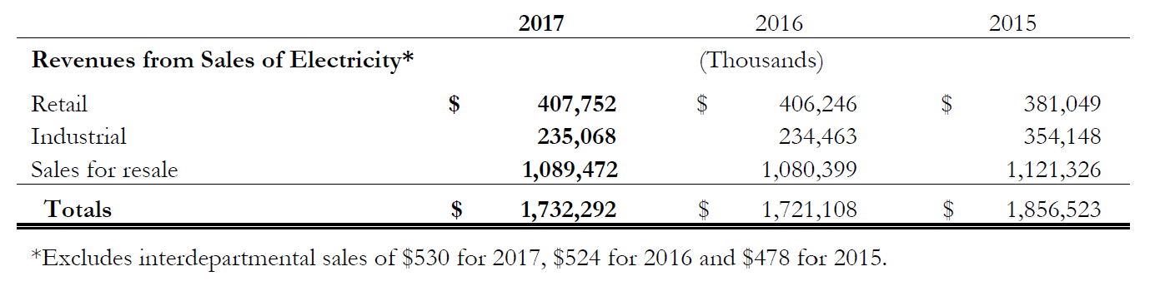
Revenues by Customer Class
48
Notes:
Here you will see a revenue breakdown by customer class.

Slide 49
Rates and Cost Recovery
Rate Authority
Santee Cooper’s Board is assigned rate making authority
Cost Recovery
Adjust to actual rates on over 75% of costs.
  Central contract is cost of service based where rates adjust to actual on monthly basis (fuel) or annual basis (non-fuel)
  Retail rates have fuel adjustment clauses that are based on a 3-month rolling average
  Demand sales adjustment clauses are based on a monthly true-up
Base Rate Increases (Retail)
On December 7, 2015, the Board approved a series of two retail rate increases:
  5.34% effective April 1, 2016
  2.09% effective April 1, 2017
August 11, 2017, Santee Cooper’s Board withdrew a proposed rate increase for 2018 and 2019 due to changing conditions
Approved Date | Effective Date | Rate Increase
August 2009 | November 2009 | 3.40%
September 2012 | December 2012 | 1.79%
September 2012 | December 2013 | 5.20%
December 2015 | April 2016 | 5.34%
December 2015 | April 2017 | 2.09%
CIF Charge
Currently 9% of gross revenue requirements
  Embedded within Central’s cost of service
  Embedded within Santee Cooper’s retail rate

Slide 50
Rate Competitiveness (cents/kWh)
Santee Cooper Comparison
EIA Comparison
Residential Rate (1,000 kWh)
Residential Rate
(¢/kWh)
January 2008¹
January 2018¹
2017 Annual Average²
Santee Cooper is committed to providing competitive rates
In conjunction with the 2018 budget approval, Santee Cooper reduced revenues needed by $40 million annually (2018-2020 average)
Santee Cooper’s projected rates are expected to remain competitive
Commercial Rate (3,000 kWh)
Commercial Rate
January 2008¹
January 2018¹
2017 Annual Average²
Industrial Rate (2,000 kW / 1,000,000 kWh)
Industrial Rate
January 2008¹
January 2018¹
2017 Annual Average²
Santee Cooper
SCE&G
Duke Energy (SC)
Progress (SC)
_____________________________________________
Cent/kWh are calculated based on published rate schedules.
Source: EIA Form 861 https://www.eia.gov/electricity/data/eia861/; Average rate in cents/kWh calculated by dividing total annual revenues in customer class by sales in kWh. Commercial includes lighting and other.
50

Slide 51
Central Coordination Agreement
51

Slide 52
The Central/Santee Cooper Coordination Agreement (CA)
Central entered into the Coordination Agreement (CA) with Santee Cooper in 1980
  Each cooperative has their own contractual agreement with Central
The CA has been amended at various times over the years; the most recent amendment was in 2013
  The 2013 amendment extended the term of the CA to December 31, 2058
    The CA cannot be terminated before December 31, 2058
    The CA includes a 10-yr termination notice provision
    Notice must be given no later than December 31, 2048 in order to terminate by December 31, 2058
  The 2013 amendment provides for cost recovery of all resources completed or under construction as of the amendment effective date, including Summer Nuclear Unit 2 and 3
  Central obtained contract extensions with all 20 cooperatives through 2058
Central’s power and energy rates are based on a cost of service model
  In addition to power and energy purchase, Central also pays directly for other services that Santee Cooper provides such as operating and maintaining Central's transmission and microwave facilities
Santee Cooper’s revenue requirements are classified (or “functionalized”) into different categories that include production fixed and variable costs, transmission, distribution, customer accounting, customer service, and other.
  Each classification of costs is then used to calculate Central’s rates and charges
52
Notes:
Key Elements of Revised Agreement: suggest moving this before time line. Also, be more specific about cost allocation revisions. Can you say whether new terms will keep 8% margin or automatic and timely pass through of costs?

Slide 53
CA – Sale of Santee Cooper
The CA cannot be assigned by either party without written consent of the other party
Upon dissolution of Santee Cooper :
  Central will have the option to purchase a percentage interest in Shared Resources that are generation facilities owned by Santee Cooper
  Central will have the option to purchase a percentage interest in Santee Cooper owned transmission facilities and lines to the extent those facilities and lines were used to serve Central
Should ownership, management, or control of Santee Cooper or of all or a majority of its electric system assets be transferred, sold, or leased, Central shall be entitled to terminate the CA by providing ninety (90) days written notice.
53

Slide 54
Projected Financial Results
54

Slide 55
Projected Revenues and Financial Metrics
The 2018 Budget achieves target metrics
Our projection assumes first base rate increase in 2020 and projected aggregate increase of ~7% implemented in years 2020- 2023
____________________________________________
Operating revenues less miscellaneous income. Includes projected rate increases..
Metrics exclude the benefit of Toshiba settlement funds.
55

Slide 56
Power Supply Overview
2017 Energy Sources
2017 Capacity
Base Load Availability
Coal
Nuclear¹
Gas
_____________________________________________
Refueling outages in fall of 2012, spring of 2014, fall of 2015 and spring of 2017 affected nuclear base load availability in those years.
Notes:
An overview of Santee Cooper’s power supply shows that it continues to have access to low cost generating units with high availability base load.

Slide 57
Future Power Supply
Santee Cooper maintains ample power supply with existing assets
to meet its customers’ needs
Forecasted Energy Requirements
Excess Capacity Above Reserve Margin^{1,2}
(MW)
0.3% CAGR 2018-2027
_____________________________________________
Excess capacity above the required reserve margin as a percentage of generation capacity of 12% in the winter and 15% in the summer; excess capacity shown above represents the lower of the winter or summer margin in the given year.
Based on load forecast 1801
Notes:
Moving forward, Santee Cooper’s projections continue to show that our existing assets provide ample power supply to meet customers’ needs without Summer Units 2 & 3 coming online. As the graphs on this slide show, Santee Cooper forecasts modest energy requirements growth over the next several years as well as excess capacity above the required reserve margin. We are continuing to evaluate all options for future power supply needs whether that be Santee Cooper-owned generation or importing purchased power.

Slide 58
Legal Matters and Nuclear Project
58

Slide 59
Major Bond Covenants
Santee Cooper has a duty to comply with provisions, covenants and agreements
contained in its Revenue Bond Resolution so long as Obligations are outstanding
STATE COVENANT WITH BONDHOLDERS AS CODIFIED BY ENABLING LEGISLATION
The Public Service Authority has power to…as necessary borrow money, make and issue negotiable notes, bonds, and other evidences of indebtedness
    - South Carolina Code Ann. §58-31-30(A)(14)
State will not alter, limit or restrict the power of the Authority to, and the Authority shall, fix, establish maintain and collect rents, tolls, rates and charges at least sufficient to provide for, among other things, the payment of principal and interest on its notes, bonds, evidences of indebtedness or other obligations
  - South Carolina Code Ann. §58-31-360
Resolution authorizing bonds may provide that in the event of default in the payment of principal and interest, or a default in the performance of any agreements, bondholders may bring suit to, among other things
  enforce all rights of bondholders,
  bring suit upon the bonds,
  require the Authority to account as if it were the trustee of an express trust for bondholders,
  enjoin any acts that are unlawful or in violation of rights of bondholders, and
  declare all principal and interest immediately due
  - South Carolina Code Ann. §58-31-40
In the event of default, enforcement authority for bond covenants given to independent trustee to
  request appointment of a Receiver,
  bring suit on behalf of bondholders,
  demand an accounting,
  accelerate balances and declare all bonds due,
  petition for mandamus or injunction, and
  per statute this list of remedies is not exclusive.

Slide 60
Major Bond Covenants (cont.)
Santee Cooper has a duty to comply with the provisions, covenants and agreements
contained in its Revenue Bond Resolution so long as Obligations are outstanding
RATE COVENANT
Establish, maintain and collect rates and other charges adequate to provide the Authority with revenues sufficient to make all payments required by law or contract, including:
  Principal, premium, and interest on Original Bonds, Revenue Bonds, Obligations;
  Obligations to the Revenue Bond Fund; the Lease Fund; the Revenue Obligation Fund; and the Capital Improvement Fund
  Operation & Maintenance expenses
Should the Authority fail to fix adequate rates and other charges the Bond Trustee, upon request of bondholders of 25% in principal amount of Revenue Bonds outstanding, may bring court action to compel fixing, establishing, and collecting adequate rates and other charges
A default of the Authority on its obligations also entitles the Bond Trustee to the appointment of a receiver who may take possession of the Authority and operate and maintain it, and fix, collect and receive rates, tolls and charges sufficient to pay all expenses of the Authority
  - South Carolina Code Ann. §58-31-40

Slide 61
Major Bond Covenants (cont.)
Santee Cooper has a duty to comply with provisions, covenants and agreements
contained in its Revenue Bond Resolution so long as Obligations are outstanding
PROHIBITION ON SALE, LEASE OR OTHER DISPOSITION OF PROPERTIES
The Authority may not sell, lease or otherwise dispose of any part of its properties so long as Revenue Bonds are outstanding unless said disposition is in compliance with requirements set forth in the Revenue Bond Resolution
  (e.g., does not require amendment of the Revenue Bond Resolution in a manner materially adverse to the interests of bondholders and does not hinder ability to maintain remaining properties in good condition)
AND
Board of Directors determines such action is desirable in the conduct of the Authority's business and doesn't impair its ability to comply with Rate Covenant

Slide 62
Major Bond Covenants (cont.)
Santee Cooper has a duty to comply with provisions, covenants and agreements
contained in its Revenue Bond Resolution so long as Obligations are outstanding
EVENTS OF DEFAULT UNDER THE REVENUE BOND RESOLUTION
Failure to punctually pay principal when due
Failure to punctually pay interest on Obligations due, with default continuing for 30 days
Failure to perform any covenant or agreement of the Revenue Bond Resolution, with failure continuing for 90 days after notice of default
Authority adjudicated bankrupt or insolvent, or should it institute proceedings to be adjudicated bankrupt or insolvent
Default under Indenture or Revenue Bond Resolution
Default under any other evidence of indebtedness (i.e., Santee Cooper’s credit facilities)
In the event of default the Trustee or bondholders of 25% in principal amount of outstanding Obligations may declare principal & interest immediately due
  This right of the Trustee is also codified at S.C. Code Ann. §58-31-40

Slide 63
Major Bond Covenants (cont.)
Santee Cooper has a duty to comply with provisions, covenants and agreements
contained in its Revenue Bond Resolution so long as Obligations are outstanding
EVENTS OF DEFAULT UNDER CREDIT FACILITIES
Authority shall cease to exist or substantially all of its assets are sold to, or merged or consolidated with another person or entity
Change in the ownership, management or control of the Authority, or there shall be a sale, lease, or transfer of all or a portion of the system of a sort that gives Central the right to terminate Coordination Agreement
  Relevant Portion of Central Coordination Agreement: …if ownership, management or control of the Authority or of all or a majority of its electric system assets is transferred, sold or leased to any person, corporation or other entity, Central shall be entitled to terminate this Coordination Agreement at any time by providing ninety (90) days’ written notice to the Authority or such person, corporation or other entity.

Slide 64
Specific Legal Matters
Petition for Original Jurisdiction
Cook v. Santee Cooper et al.
Santee Cooper filed a petition for original jurisdiction with the South Carolina Supreme Court
Defendants are Central Elec. Power Cooperative, Palmetto Elec. Power Cooperative, and individual ratepayers who were named because they are parties to Cook action
Santee Cooper seeks a declaration that the Enabling Legislation mandates rates be set to recover all costs, expenses, debt service, and other financial obligations, including those related to V. C. Summer Units 2 & 3
Central and Palmetto filed a return opposing Santee Cooper’s request for the Court to exercise its original jurisdiction to which Santee Cooper filed a reply; the ratepayers’ return is due by August 27
Cook et al. v. Santee Cooper, Individual Board Members, Central Elec. Coop., et al.
  Pending in state court
  Filed on behalf of customers, served directly or indirectly, who paid utility bills which included costs related to V. C. Summer Units 2 & 3, nuclear generation units in Fairfield County
  Central and Palmetto Electric Cooperatives, both co-defendants in Cook, filed cross-claims against Santee Cooper and its Board (see following page)

Slide 65
Specific Legal Matters (cont.)
Central Cross-Claims in Cook
Central, a co-defendant in Cook, filed cross-claims against Santee Cooper and its Board, alleging:
  Charging Central for costs associated with the nuclear units is a breach of statute because the project was abandoned and therefore not “used or useful”
  Charging Central for costs associated with the nuclear units is unreasonable and violates the contractual duty of good faith and fair dealing; thus, a breach of the Coordination Agreement
  Central is entitled to approximately 70% of the Toshiba settlement
  Directors breached statutory duties to Central
Santee Cooper has responded to written discovery requests and FOIA requests from Central
Central Motion
Central filed a motion asking the Court to order a portion of the rates related to V. C. Summer Units 2 & 3, owed to Santee Cooper by Central, be deposited with the court during the pendency of this case
The Court denied the motion

Slide 66
Nuclear Project
Since the construction suspension in summer of 2017, the project site has been undergoing construction site wind down and site stabilization
Wind Down Participants
SCANA and Saulsbury Industries are currently taking the primary roles in the site wind down activities; Saulsbury replaced Fluor on this scope of work in February
Santee Cooper is negotiating with SCANA for ownership of the equipment
Wind Down Activities
Restoring to stable site
Performing civil work to close out environmental permits
Relocating equipment from offsite warehouses to site to eliminate offsite warehouse lease costs
Nuclear License
In Dec 2017 SCANA asked the NRC to withdraw its Units 2 and 3 nuclear license (COL)
In Jan 2018 Santee Cooper asked the NRC to delay decision on COL until Summer 2018
Santee Cooper and SCANA received a letters from the NRC in April 2018 stating the Commission’s intent to make a decision on the COLs by August 31, 2018
Santee Cooper is nearing completion of its COL evaluation process and anticipates a Board decision soon.
Wind Down Costs
Santee Cooper’s share is approximately $39 million (2017 and 2018)
This represents the final amount to be spent on wind down activities
Ongoing Site
Maintenance Cost
Estimated $16 million annually to maintain the site equipment (Santee Cooper cost @ 100%)
In June 2018, the Santee Cooper Board instructed staff to implement an equipment maintenance program for a six month period.
Disposition of Equipment
Santee Cooper will continue to evaluate the value of preserving assets and anticipates further Board guidance near the end of 2018.

Slide 67
Questions?
67

